Slide 1
Angular Basics
Laura-Elena Comanac

Slide 2
Who?
Laura-Elena Comanac

Slide 3
Agenda and ”Rules”
Introduction
Learning by practice
Feel free to ask questions anytime
Casual atmosphere
Open discussion ☺

Slide 4
Perequisites
No previous experience needed
Angular IDE
Visual Studio Code, Stackblitz or other
GitHub
Let’s begin!

Slide 5
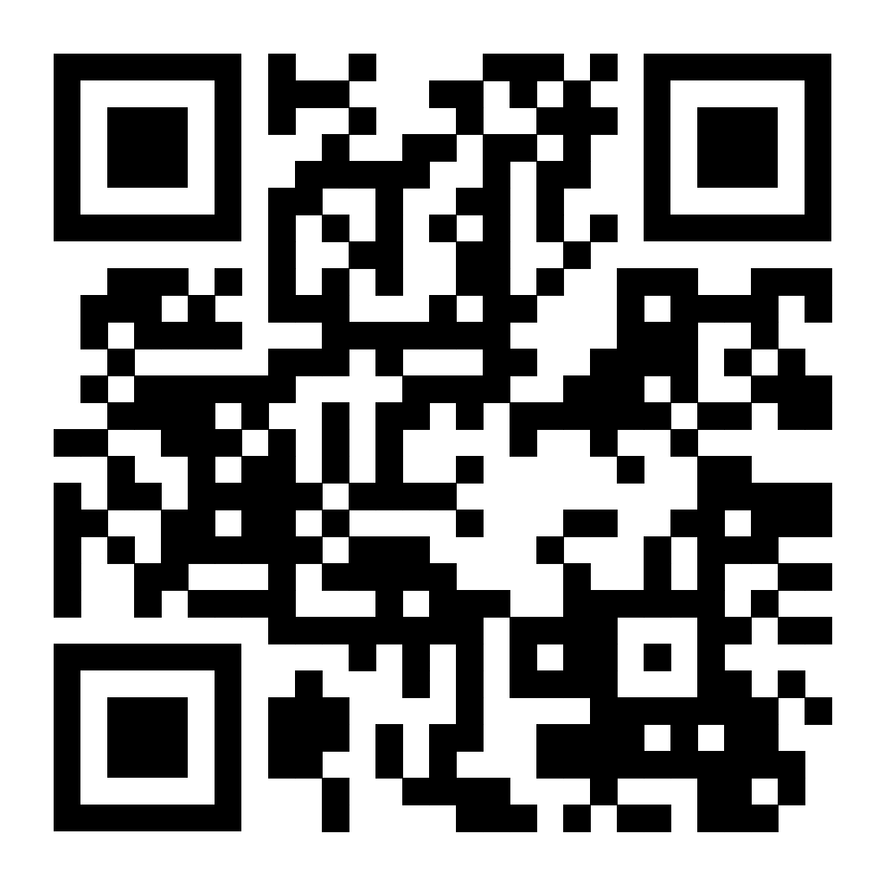
https://github.com/Laura-ElenaComanac/AngularWorkshop

Slide 6
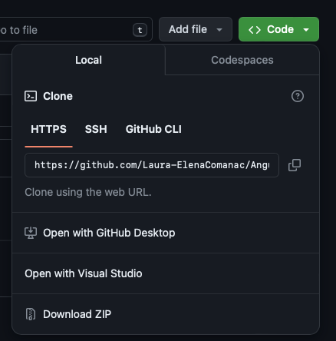
Setup
Useful commands:
git clone
npm install - -force
ng serve
ng generate component / service

Slide 7
What is Angular?

Slide 8

Angular Basics
Components and Routing
Classes and Variables
Interpolation
Property Binding
Event Binding
Two-way Binding
Directives and Services

Slide 9
https://angular.io/docs
References

Slide 10
Thank You!
Laura-Elena Comanac

